Slide 1


PRATHYUSHA ENGINEERING COLLEGE
(An AUTONOMOUS INSTITUTION)
DEPARTMENT OF ELECTRONICS AND COMMUNICATION ENGINEERING
FINAL PROJECT REVIEW
TITLE: Motor Fault Detection Using Vibration Analysis
and Machine Learning
INTERNAL GUIDE NAME : Dr. N. Sujitha
DESIGNATION: Asst. Professor
EXTERNAL GUIDE NAME : Arumugam
DESIGNATION: Head of Operations
PRESENTED BY :
Dhinesh kumar H (1114422106009)
Sreeman ab (111422106044)
Vikram m (111422106051)
ECE
Department of Electronics and Communication Engineering

Slide 2
PRATHYUSHA ENGINEERING COLLEGE
(An AUTONOMOUS INSTITUTION)
Objectives
Literature Survey
Existing Problem , Proposed System & Scope of the Project
List of Modules
Module Description Architecture diagram
Output & Results
Outcome of the Project
Conclusion & Future Enhancements
References
Internship certificate
Conference Certificate
ECE
Department of Electronics and Communication Engineering

Slide 3
PRATHYUSHA ENGINEERING COLLEGE
(An AUTONOMOUS INSTITUTION)
OBJECTIVES
• To design and develop a motor fault detection system using vibration analysis. • To collect vibration signals using an ADXL345 accelerometer sensor mounted on the motor bearing. • To extract vibration features such as RMS, Peak value, Standard Deviation, and Kurtosis. • To apply Machine Learning algorithms (SVM and Random Forest) for motor fault classification. • To detect motor conditions such as Normal, Inner Race Fault, and Outer Race Fault. • To enable early fault detection and predictive maintenance.
ECE
Department of Electronics and Communication Engineering

Slide 4
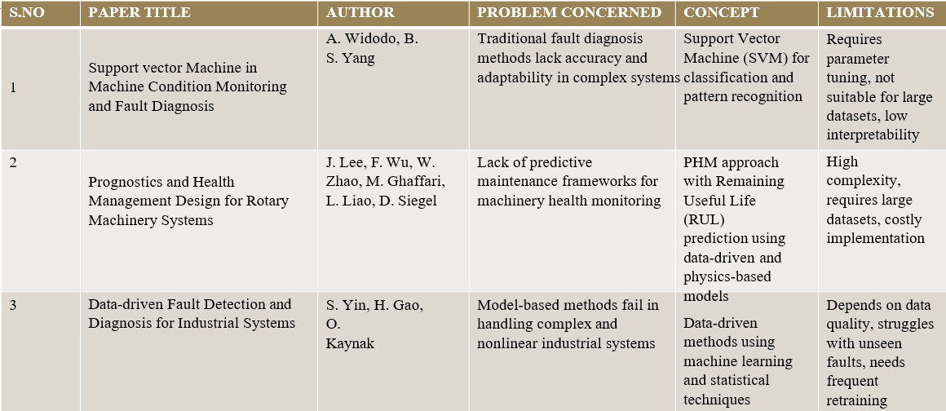
PRATHYUSHA ENGINEERING COLLEGE
(An AUTONOMOUS INSTITUTION)
LITERATURE SURVEY
ECE
Department of Electronics and Communication Engineering

Slide 5
PROJECT SCOPE, EXISTING SYSTEM & PROPOSED SYSTEM
PRATHYUSHA ENGINEERING COLLEGE
(An AUTONOMOUS INSTITUTION)
PROJECT SCOPE
Monitor vibration of warehouse equipment such as conveyor motors
Apply machine learning to identify abnormal vibration patterns
Enable predictive maintenance in warehousing and logistics operation
EXISTING SYSTEM
Maintenance is based on periodic manual inspection
Faults are detected only after failure occurs
No real-time condition monitoring is available
PROPOSED SYSTEM
Continuous vibration monitoring using IoT sensors
AI-based fault detection for early warning
Centralized web dashboard for equipment health monitoring
ECE
Department of Electronics and Communication Engineering

Slide 6
PRATHYUSHA ENGINEERING COLLEGE
(An AUTONOMOUS INSTITUTION)
LIST OF MODULUES
• Vibration Signal Acquisition Module • Data Acquisition and Microcontroller Module • Signal Processing Module • Feature Extraction Module • Machine Learning Classification Module • Monitoring Dashboard Module
ECE
Department of Electronics and Communication Engineering

Slide 7
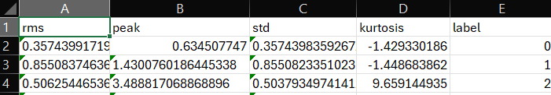
PRATHYUSHA ENGINEERING COLLEGE
(An AUTONOMOUS INSTITUTION)
MODULE DESCRIPTION
Data Acquisition Module
ESP32 microcontroller collects vibration data from the sensor through I²C communication.
Feature Extraction Module
Statistical parameters such as RMS, Peak,Standard Deviation, and Kurtosis are extracted using accelerometer
Machine Learning Module
Algorithms used: • Random Forest
Dataset used: • Motor vibration dataset generated from sensor readings and simulated fault data.
ECE
Department of Electronics and Communication Engineering

Slide 8
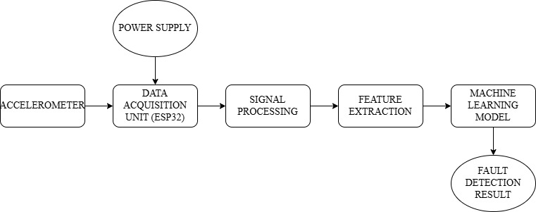
PRATHYUSHA ENGINEERING COLLEGE
(An AUTONOMOUS INSTITUTION)
System Architecture:
ECE
Department of Electronics and Communication Engineering

Slide 9

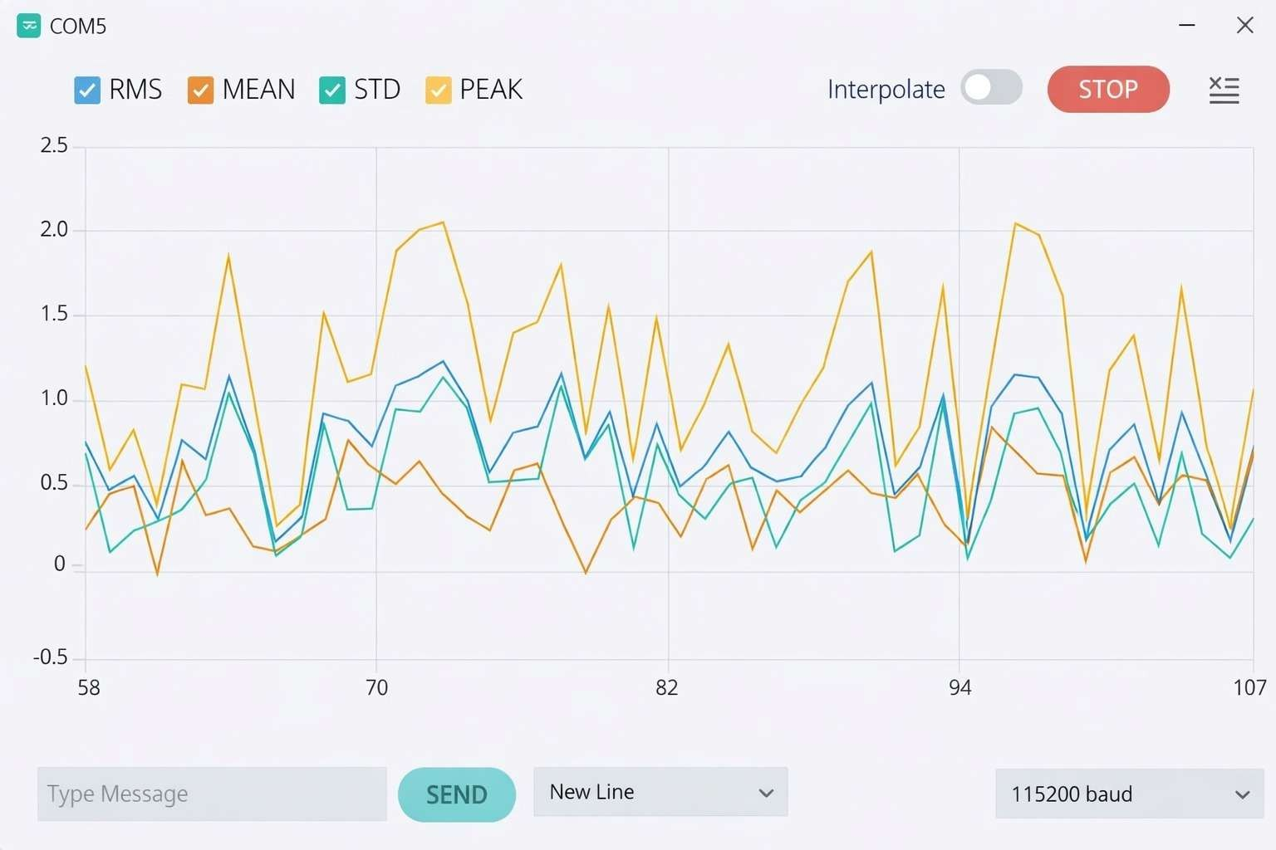
PRATHYUSHA ENGINEERING COLLEGE
(An AUTONOMOUS INSTITUTION)
EXPERIMENTAL RESULTS– Vibration Signal Acquisition
VIBRATION SIGNALS WHICH IS SENT FROM ACCELEROMETER TO ESP32
ECE
2
Department of Electronics and communication Engineering

Slide 10
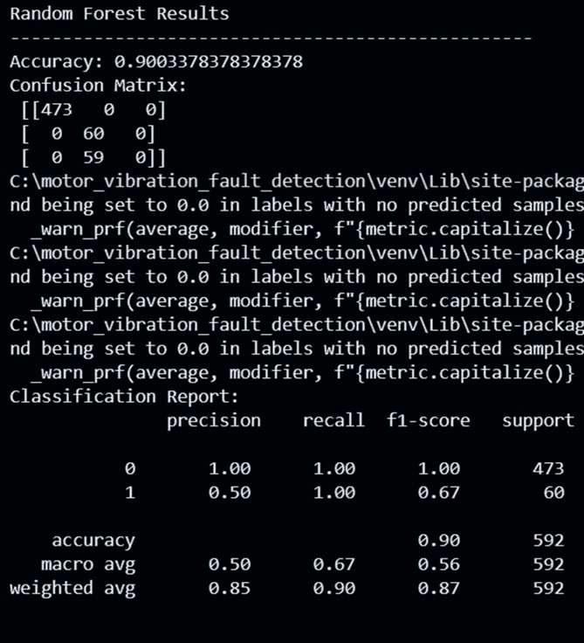
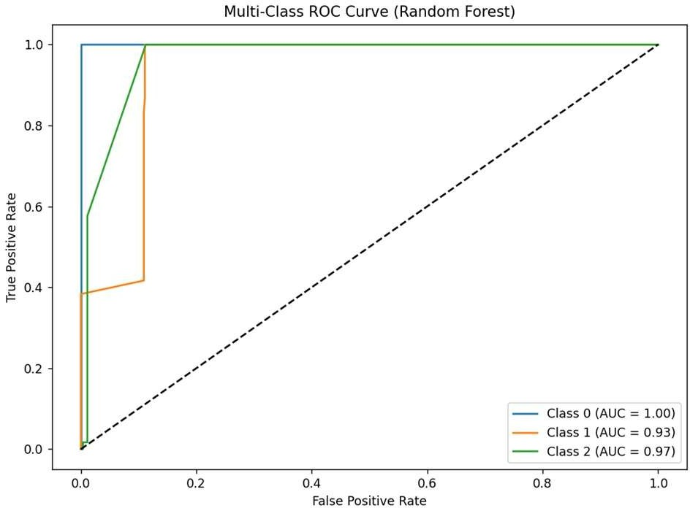
PRATHYUSHA ENGINEERING COLLEGE
(An AUTONOMOUS INSTITUTION)
EXPERIMENTAL RESULTS – (Random Forest)
ECE
2
Department of Electronics and communication Engineering

Slide 11
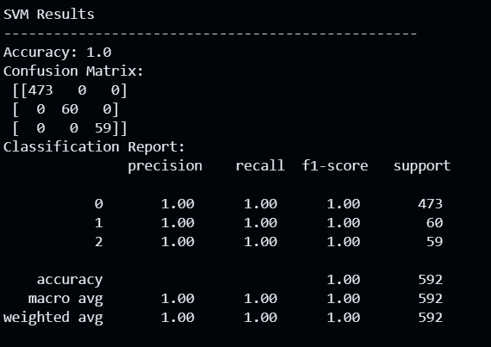
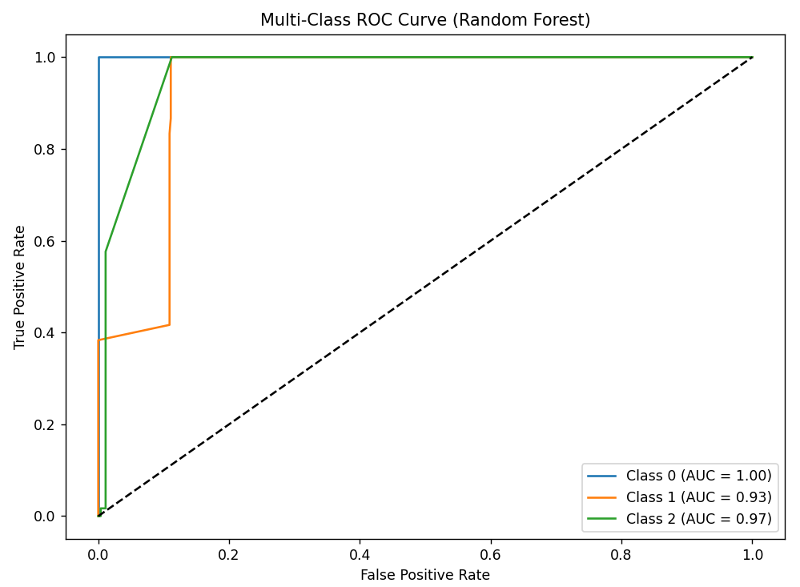
PRATHYUSHA ENGINEERING COLLEGE
(An AUTONOMOUS INSTITUTION)
Experimental Results (Support Vector Machine)
ECE
2
Department of Electronics and communication Engineering

Slide 12
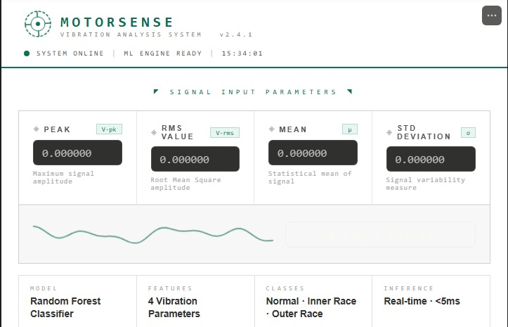
PRATHYUSHA ENGINEERING COLLEGE
(An AUTONOMOUS INSTITUTION)
EXPERIMENTAL RESULTS– PREDICTIVE ANALYSIS
UI DASHBOARD
ECE
2
Department of Electronics and communication Engineering

Slide 13
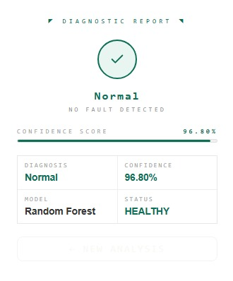
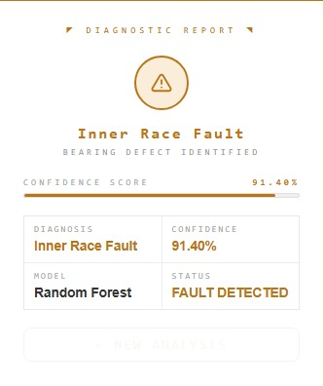
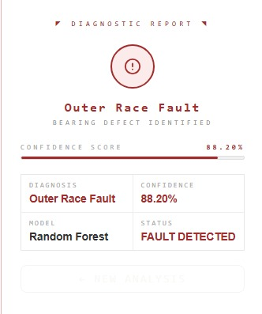
PRATHYUSHA ENGINEERING COLLEGE
(An AUTONOMOUS INSTITUTION)
EXPERIMENTAL RESULTS– PREDICTIVE ANALYSIS
OUTPUT OF PREDICTIVE ANALYSIS
ECE
2
Department of Electronics and communication Engineering

Slide 14
CONCLUSION & FUTURE WORKS:
PRATHYUSHA ENGINEERING COLLEGE
(An AUTONOMOUS INSTITUTION)
The proposed motor fault detection system successfully monitors motor vibration and identifies abnormal operating conditions using vibration analysis and machine learning techniques. In this project, an accelerometer sensor is used to capture vibration signals from the motor, and the data is collected through the ESP32 microcontroller. The vibration signals are processed to extract important statistical features such as Root Mean Square (RMS), Peak value, Standard Deviation, and Kurtosis.
These extracted features are analyzed using a machine learning model to classify the motor condition. The system is capable of distinguishing between different operating conditions such as normal motor operation and fault conditions. The results are displayed through a monitoring interface, enabling easy interpretation of the motor health status.
The developed system demonstrates that vibration-based monitoring combined with machine learning provides an effective approach for early fault detection in rotating machinery. This helps in reducing unexpected failures, improving equipment reliability, and supporting predictive maintenance in industrial environments.
ECE
Department of Electronics and Communication Engineering

Slide 15
PRATHYUSHA ENGINEERING COLLEGE
(An AUTONOMOUS INSTITUTION)
REFERENCES:
[1] Y. Lei, N. Li, L. Guo, N. Li, T. Yan, and J. Lin, “Machinery health prognostics: A systematic review from data acquisition to RUL prediction,” Mechanical Systems and Signal Processing, vol. 104, pp. 799–834, 2020.
[2] M. Carvalho, T. P. Nascimento, and R. A. da Silva, “Machine learning based vibration analysis for rotating machinery fault diagnosis,” IEEE Access, vol. 8, pp. 194318–194329, 2020.
[3] H. Shao, H. Jiang, H. Zhang, and T. Liang, “Rolling bearing fault diagnosis using deep learning and vibration signal analysis,” IEEE Transactions on Industrial Electronics, vol. 67, no. 5, pp. 4089–4099, 2021.
[4] Z. Zhang, Y. Li, and J. Wang, “Intelligent fault diagnosis of rotating machinery using machine learning algorithms,” Sensors, vol. 21, no. 12, pp. 1–18, 2021.
[5] X. Li, W. Zhang, and Q. Ding, “Deep learning based machinery fault diagnostics with big data,” IEEE Transactions on Industrial Informatics, vol. 17, no. 5, pp. 3215–3225, 2022.
[6] A. K. Verma and S. Sharma, “Vibration based fault diagnosis of induction motors using machine learning techniques,” Measurement, vol. 196, pp. 111–120, 2022.
[7] J. Chen, Y. Liu, and H. Wang, “IoT based intelligent monitoring system for industrial motor fault detection,” IEEE Internet of Things Journal, vol. 10, no. 3, pp. 2301–2312, 2023.
[8] P. Singh and R. Kumar, “Predictive maintenance of rotating machinery using vibration analysis and machine learning,” IEEE Access, vol. 11, pp. 45211–45223, 2023.
[9] L. Zhao, Y. Chen, and X. Li, “A machine learning framework for vibration-based fault diagnosis of rotating equipment,” Sensors, vol. 24, no. 2, pp. 1–15, 2024.
[10] K. Patel and S. Mehta, “AI-based predictive maintenance for industrial motors using vibration monitoring,” IEEE Access, vol. 12, pp. 14522–14534, 2025.
[11] S. Chen, J. Liu, and H. Zhang, “Intelligent fault diagnosis of rotating machinery using vibration signal analysis and machine learning techniques,” IEEE Access, vol. 9, pp. 118321–118332, 2021.
[12] Y. Li, Z. Zhao, and X. Wang, “Vibration-based condition monitoring of industrial motors using machine learning algorithms,” Sensors, vol. 22, no. 8, pp. 1–15, 2022.
[13] R. Kumar and P. Singh, “Machine learning based predictive maintenance for rotating machinery using vibration signals,” Measurement, vol. 205, pp. 112–121, 2023.
[14] H. Wang, L. Zhang, and Y. Chen, “IoT-enabled vibration monitoring system for real-time motor fault diagnosis,” IEEE Internet of Things Journal, vol. 11, no. 2, pp. 2145–2156, 2024.
[15] K. Sharma and A. Patel, “Artificial intelligence based vibration monitoring system for predictive maintenance of industrial motors,” IEEE Access, vol. 13, pp. 24512–24524, 2025.
ECE
Department of Electronics and Communication Engineering

Slide 16

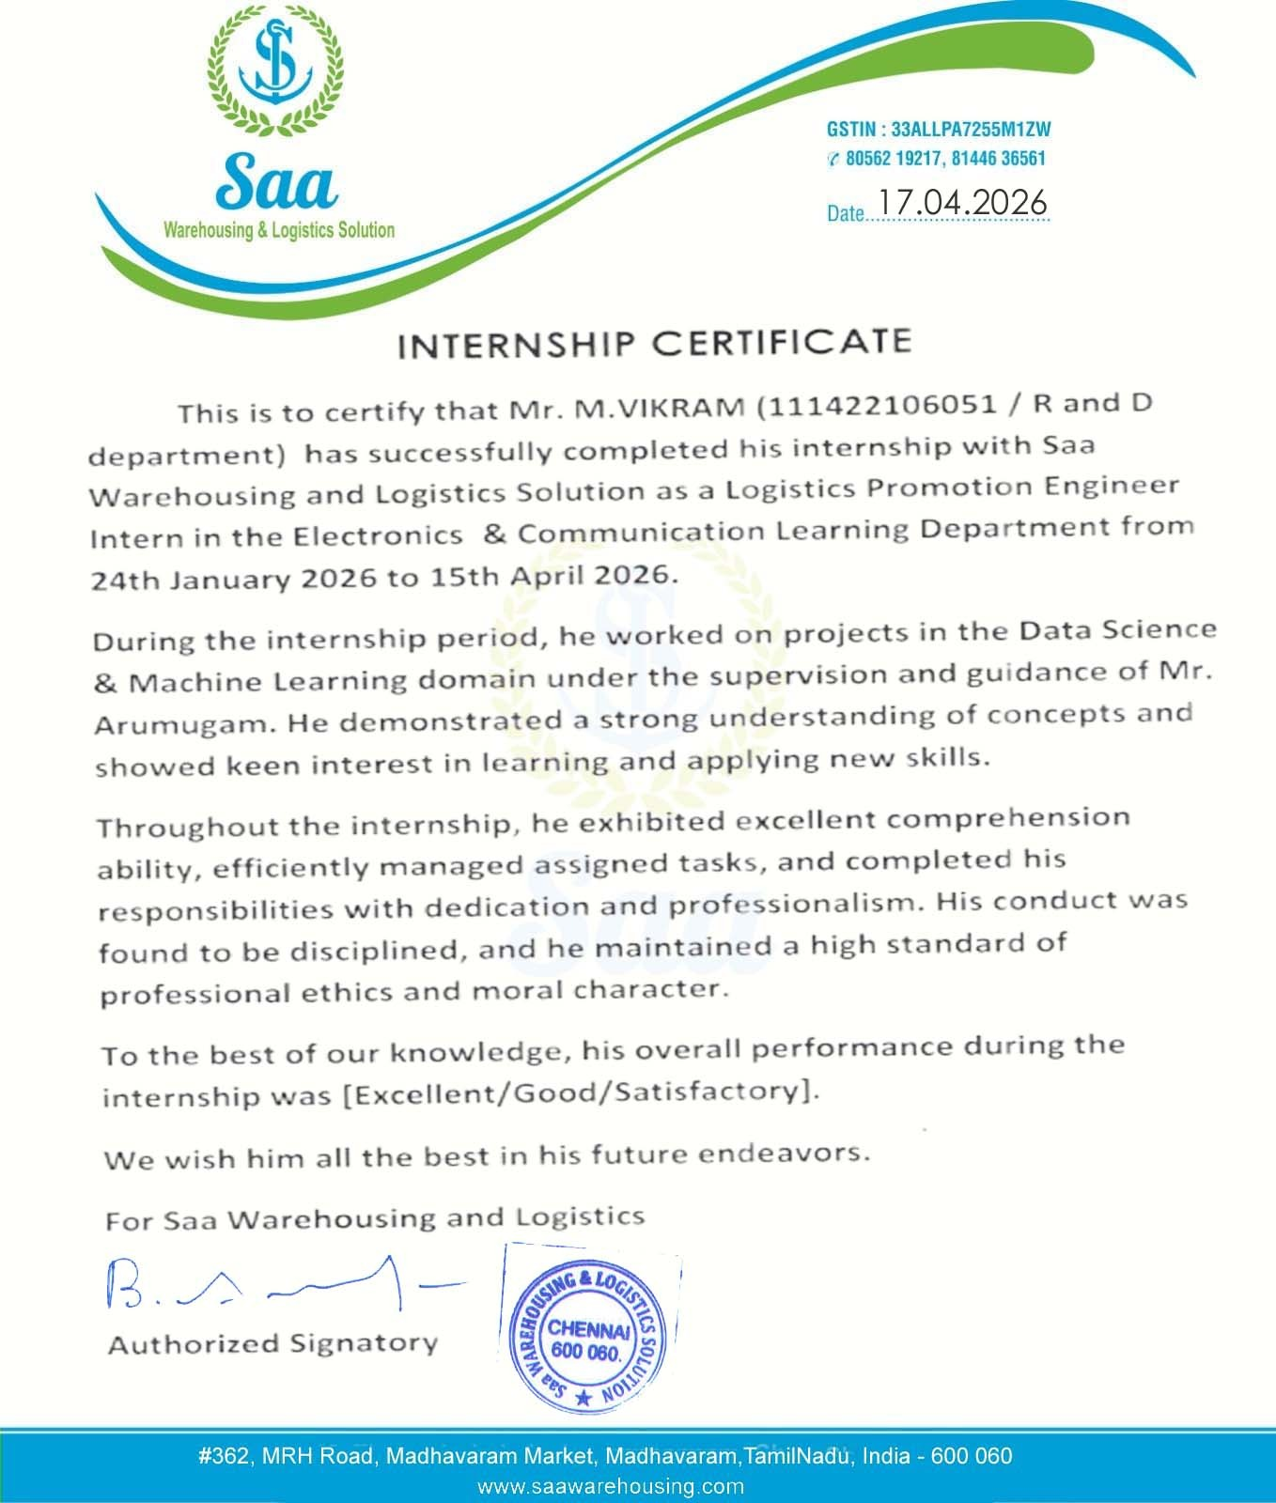
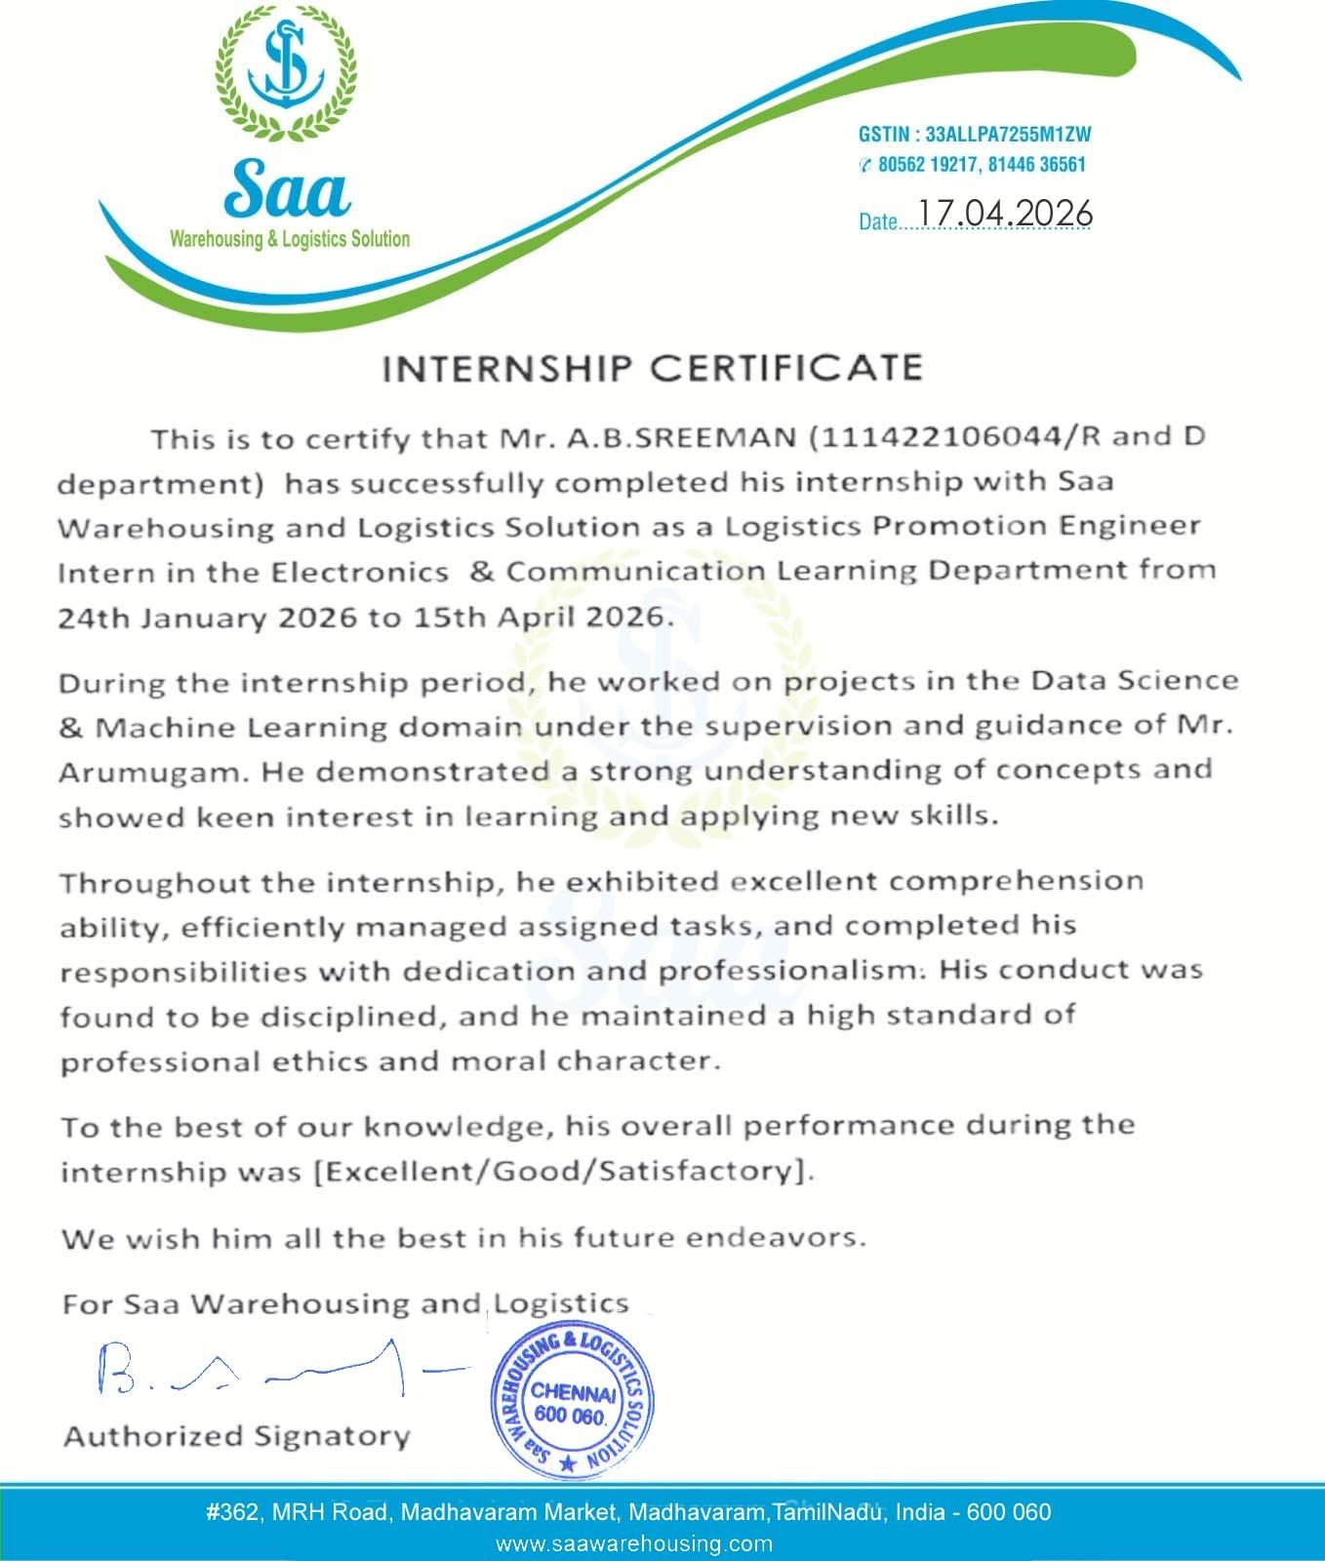
PRATHYUSHA ENGINEERING COLLEGE
(An AUTONOMOUS INSTITUTION)
INTERNSHIP CERTIFICATE
ECE
Department of Electronics and Communication Engineering

Slide 17
PRATHYUSHA ENGINEERING COLLEGE
(An AUTONOMOUS INSTITUTION)
CONFERENCE CERTIFICATE
ECE
Department of Electronics and Communication Engineering

